Slide 1
Tableau Project 2
Andreas Wong
Tutor- Idir

Slide 2
Link to workbook
Here is the link to the workbook if the link in the repo doesn’t work:
https://public.tableau.com/app/profile/andreas.wong/viz/Tableauproject2-AndreasWong/Dashboard1Task10

Slide 3
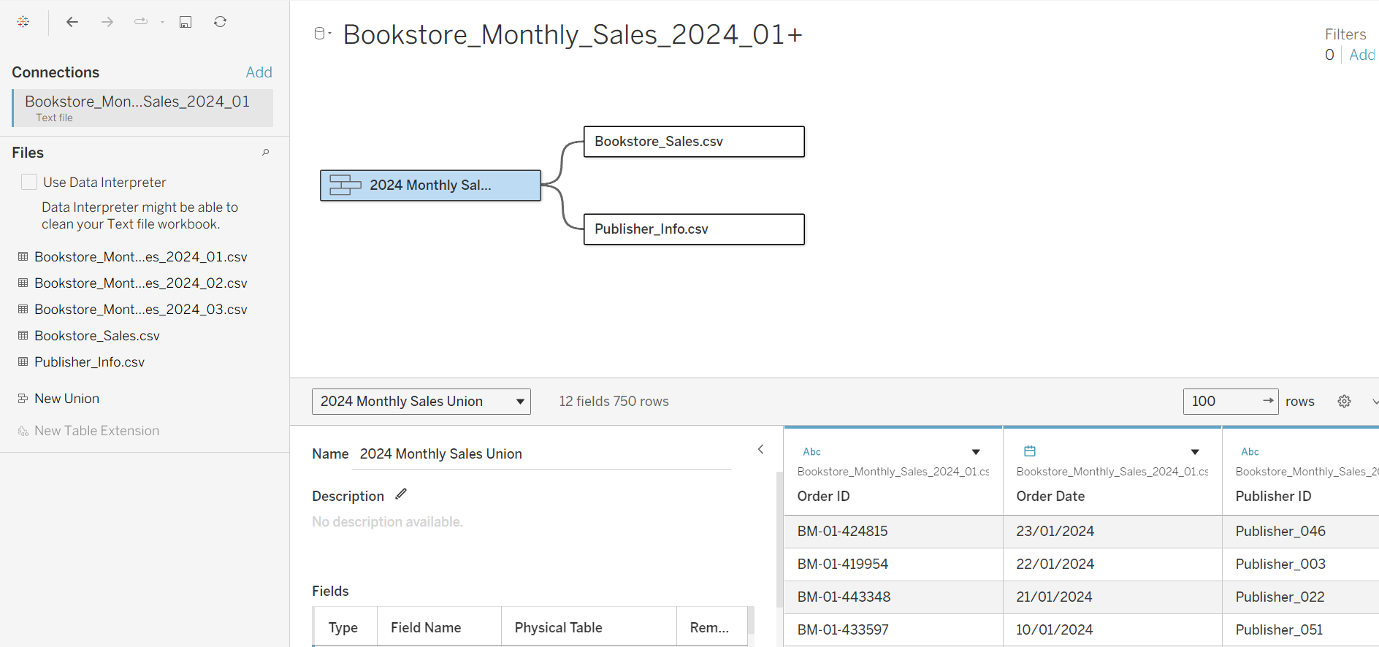
Task 1

Slide 4
Task 2
The findings from Task 2 show that History generates the most sales out of all the genres, with Sci-Fi coming a close second.
We could take two approaches, either focus marketing and purchasing on these two genres, or try and explore reasons as to why History and Sci-fi books generate the most sales and use this to try and boost sales of other genres.
The first option is probably simpler and better for short term, but long term the second option might be worth considering.

Slide 5
Task 3
We can see that the West region clearly has the highest sales.
However, we must consider that maybe the West region has more stores, so this information would be needed in order to make a prescriptive judgement.
If the West region doesn’t have more stores, we would try and look at other factors as to why the other regions don’t sell as well. (E.g. poor marketing/management?)
If the West region does have more stores, building more stores in other regions should be considered.

Slide 6
Task 4
Looking at the graph, with the exception of a few outliers, for all regions and genres, I spotted a pattern of sales increasing in the first half of each month, then decreasing in the second half of the month.
Maybe one reason is that if payday is at the end of each month, customers may have more disposable income at the beginning of the month, hence will spend more in the first half of the month.
Measures should be taken to try and boost sales in the second half of the month, for example through more marketing or offering special deals/discounts.

Slide 7
Task 5
The top performing publisher is Publisher 13
The bottom performing publisher is Publisher 58.
One thing to act on from this would be to focus on selling more from the top performing publishers.
Although again, the lowest performing publisher might simply not have as many books, so in fact, a better measure would be to judge each publisher by adjusting for the number of books.

Slide 8
Task 6
Looking at the average sales per order for the regions, they are actually fairly close together.
Combined with the visual from Task 3, this shows that the West region is making much more revenue per order despite not actually having much more sales per order, and also not having a higher average unit price than the East region.
More research needs to be done into the West region to find out why exactly this is the case, and how this information can be used to increase revenue per order for the other regions.
Looking at the order size visual, the vast majority of large orders are from the west, which could be another reason why.

Slide 9
Task 7
In line with most of our previous analysis, the West Region is performing the best across all genres.
The East region seems to moderately sell well in History and Non-Fiction, so maybe this is an area they can focus purchasing and marketing on.
The South region is the weakest by far, so the most focus should be on this region to try and find ways to improve sales.

Slide 10
Task 8
There aren’t really any outliers in terms of high-quantity or high-sales, although among the highest sale/highest quantity orders, History, Sci-Fi and Non fiction are all among them.
Task 2 showed that History and Sci-Fi were two of the highest selling genres, which is supported by what we found in this task.
Looking at the highest sales in each quantity, there is an increase of around $40/50 for each increase in quantity (by one) which supports that there are no noteworthy outliers.

Slide 11
Task 9
The West has the highest cumulative sales, as expected from all the previous analysis that has been done.
When setting targets for Q2, each region should have a separate target, based on forecasts for Q2. If the region exceeds the target sales by a reasonable margin, we could conclude that whatever changes we made because of the previous tasks were successful.
In the opposite case, this would mean the measures we took were not enough to improve the sales of the Non-West regions, meaning we would have to iterate on this process for Q3.

Slide 12
Task 10
See the first link in email/2nd slide

